Slide 1
Data acquisition and Data wrangling
Asha Sandeep
Noida
Digichrome Acedemy

Slide 2
Introduction
Data Wrangling is the process of gathering, collecting, and transforming Raw data into another format for better understanding, decision-making, accessing, and analysis in less time. Data Wrangling is also known as Data Munging.

Slide 3
Project Overview
The purpose of the data wrangling project is to clean, transform, and prepare raw data for analysis and modeling. This involves processing data from various sources, such as databases, spreadsheets, to ensure its quality, consistency, and usability. The scope of the project includes:
Data collection,Data cleaning,
Data integration,Data transformation,Data Integration
Quality assurance,Documentataion etc.

Slide 4
Project Overview
Timeline :- 20st march,2024.
Deadline :- 30th April,2024.

Slide 5
Problem Statement
The problem statement in a data wrangling project defines the specific challenges or issues that need to be addressed through the data cleaning, transformation, and preparation process. It articulates the objectives and goals of the project and provides context for the data wrangling tasks.

Slide 6
Solution
I got the solution from the geeks for geeks articles and google .

Slide 7
Methodology
Different methods for data wrangling:
1. Merge datasets
2. Identify unique values
3. Drop unnecessary columns
4. Check the dimensions of the dataset
5. Check the datatype of the dataset
6. Check datatype summary
7. Treat missing values
8. Validate the correctness of the data at the primary level if applicable

Slide 8
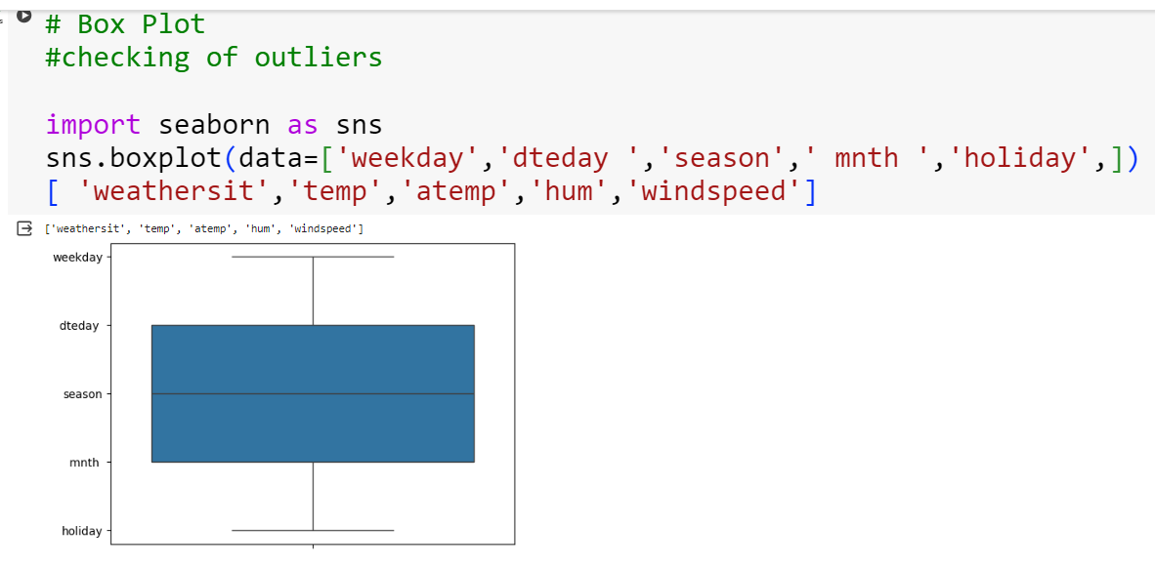
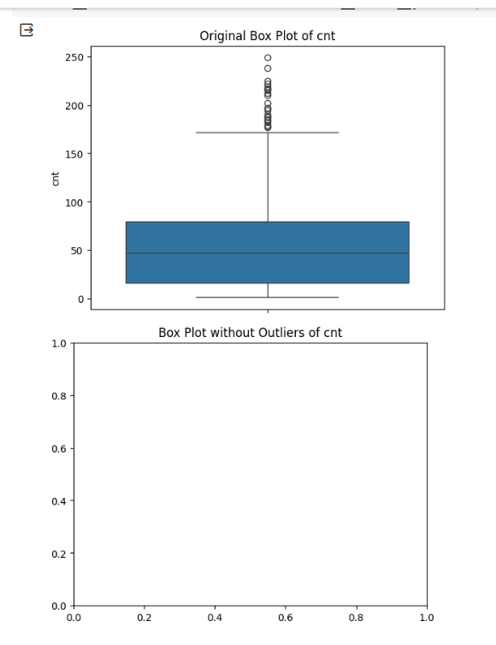
Box plot chart
import seaborn as sns
import matplotlib.pyplot as plt
def removal_box_plot(df, column, threshold):
sns.boxplot(df[column])
plt.title(f'Original Box Plot of {column}')
plt.show()
removed_outliers = df[df[column] <= threshold]
sns.boxplot(removed_outliers[column])
plt.title(f'Box Plot without Outliers of {column}')
plt.show()
return removed_outliers
threshold_value = 0.12
no_outliers = removal_box_plot(Weather_count, 'cnt', threshold_value)

Slide 9
Key features
There are some steps for data wrangling.
They are as follows
Data discovery
Data structuring
Data cleaning
Data Enriching
Data Validating
Data Publishing

Slide 10
Result & Achievements
Results of the data analysis in a clear and understandable
manner to stakeholders,decision-makers,or other
interested parties .
learnings outcome
Technical Skills:
1. Data Acquisition
2. Data Wrangling

Slide 11
Challenges faced
I faced the challenges during data wrangling
1-Error occur and findings their accurate solution .
2-Sometime i occur the problem NAN value came in output.

Slide 12
Conclusion
We have seen how datasets can be processed and cleaned using Pandas and NumPy library and how we can perform various techniques to clean it up.

Slide 13
Thank you

